Slide 1
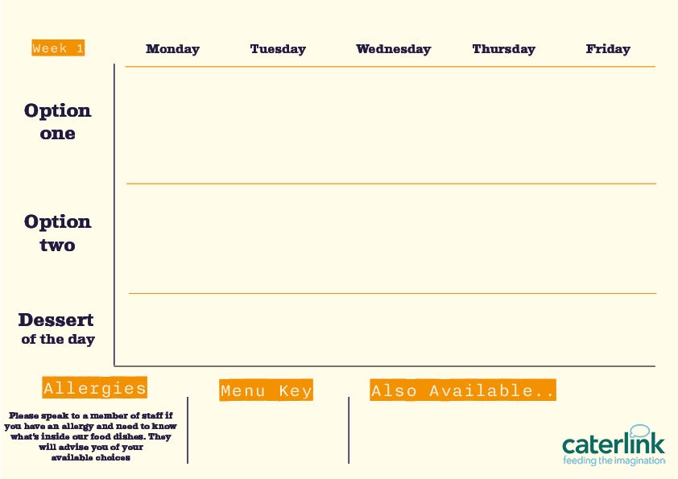









Autumn/Winter Menu 2026
Roast Chicken with all the Trimmings
with Roast Potatoes, Stuffing, Carrots, Broccoli and Gravy
Beef Meatballs
with Spaghetti and garlic bread
Chicken Tikka Masala
with 50/50 Rice
Mexican Beef chilli
with 50/50 rice or soft taco
Battered Fish
With chips and Peas
Quorn Roast with all the Trimmings
with Roast Potatoes, Stuffing, Seasonal Veg and Gravy
Vegan meatball pasta bake
with Garlic bread
Vegan Sausage
With Chips and peas
Sticky Soy and honey noodles
With steamed vegetables
Mexican vegetable rice
Fruit and Yogurt
Chocolate Brownie
Fruit
and Yogurt
Jam & Coconut Sponge
Fruit and Yogurt
Vegan option
Our hot and cold grab & go selection alongside soup of the day and filled jacket potatoes
Added plant protein
Source of wholemeal

Slide 2




Autumn/Winter Menu 2026
Mac and Cheese with Toppings
Croutons, Crispy Onions, Spring Onions, Barbecue Beans
Classic Butcher’s Sausages
with Mash seasonal vegetables & onion Gravy
Fish fingers or salmon
fishcake
with chips
Spicy Chicken
with khobez and tabbouleh salad
Original Spice Chicken
with paprika Wedges and Rainbow Slaw
Quorn & Black bean Fajitas
with rice
Veggie sausages
with Mash, seasonal vegetables & onion Gravy
Broccoli and Feta Quiche
with Vegetables
Sweet Potato, Chickpea & Spinach Tikka
with 50/50 Rice
and Sambals
Smokey Bean
Burger
with paprika Wedges and Rainbow Slaw
Fruit and Yogurt
Blondie with berries
Fruit
And yogurt
Old School Cake
with Custard
Fruit and yogurt
Vegan option
Our hot and cold grab & go selection alongside soup of the day and filled jacket potatoes
Added plant protein
Source of wholemeal

Slide 3






Autumn/winter Menu 2026
Roast Chicken with all the Trimmings
with Roast Potatoes, Stuffing, Carrots, Broccoli and Gravy
Vegetarian Thai Noodles
With roasted vegetables
Classic beef bolognaise
with Garlic bread
Jerk Chicken Thighs
With 50/50 Rice and peas , Broccoli and Spiced Pineapple Slaw
Battered fillet of fish
With Chips and mushy peas
Roasted Vegetable Stir fry with chick peas
with Edamame Beans
Cheese and tomato pizza slice
With chips
And beans
Vegan meatball pasta bake
With Garlic bread
Vegetable and feta pastry swirl
With all the trimmings
Curried Squash & Butterbeans
with 50/50 Rice & Peas, Broccoli and
Pineapple Slaw
Fruit and Yogurt
Chocolate Cake
Fruit
And Yogurt
Apple Pie
with Custard
Fruit and yogurt
Vegan option
Our hot and cold grab & go selection alongside soup of the day and filled jacket potatoes
Added plant protein
Source of wholemeal

